Slide 1
Linux device driver
Day 14 PPT
-SUBITHRA s

Slide 2
DIFFERENCE BETWEEN STRUCTURE AND UNION
Memory:
Structure: In a structure, each member has its own separate memory space. The size of a structure is the sum of the sizes of its members.
Union: In a union, all members share the same memory space. The size of a union is determined by the size of its largest member.
Data Organization:
Structure: Each member of a structure holds a different piece of data. You can access each member independently.
Union: All members of a union share the same memory location. Only one member of a union can be active (contain a valid value) at a time. Writing a value to one member of a union will overwrite the contents of the other members.
Usage:
Structure: Typically used when you need to represent a collection of related data elements, each with its own distinct meaning.
Union: Used when you need to store different types of data in the same memory space, but only one type is active at any given time. Unions are commonly used in situations where you want to save memory by sharing storage among multiple variables or when implementing variant data types.

Slide 3
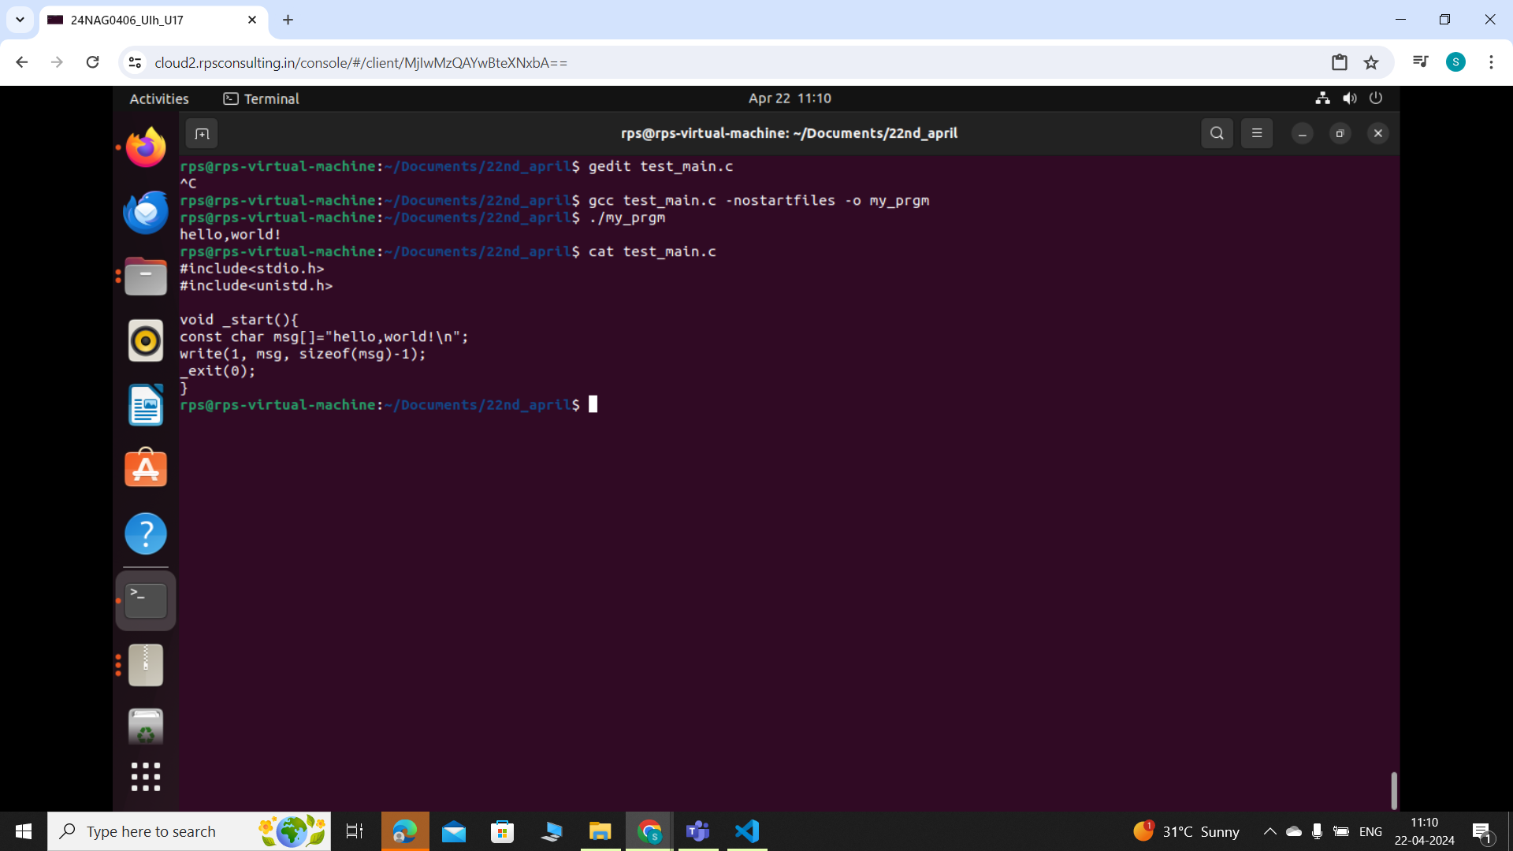
WITHOUT MAIN
#include <stdio.h>: This line includes the standard input-output header file, which provides functions like printf.
#include <unistd.h>: This line includes the POSIX operating system API header file, which provides access to various operating system functionalities, including system calls like write.
void _start(): This defines the _start function, which is the entry point of the program's execution. Unlike the typical main function, _start is called directly by the operating system startup code.
const char msg[] = "hello, world!\n";: This defines a constant character array named msg containing the string "hello, world!\n".
write(1, msg, sizeof(msg)-1);: This line calls the write system call, which writes data to a file descriptor. Here, 1 represents the standard output file descriptor (stdout). The write system call takes three arguments: the file descriptor to write to (1 for standard output), a pointer to the data to be written (msg), and the number of bytes to write (sizeof(msg)-1). We subtract 1 from sizeof(msg) to exclude the null terminator from being written.
exit(0);: This line exits the program with a return status of 0, indicating successful termination.

Slide 4
DLOPEN
SYNTAX:
#include <dlfcn.h>
void *dlopen(const char *filename, int flags);
filename: This parameter specifies the path to the shared object file (shared library) that you want to load dynamically.
flags: This parameter specifies flags controlling how the library is opened. Some commonly used flags include:
RTLD_LAZY: Perform lazy binding, resolving symbols as they are referenced.
RTLD_NOW: Perform immediate binding, resolving all undefined symbols when the library is loaded.
RTLD_GLOBAL: Symbols in the library will be made available for symbol resolution of subsequently loaded libraries.
RTLD_LOCAL: Symbols in the library are not made available for symbol resolution of subsequently loaded libraries.

Slide 5
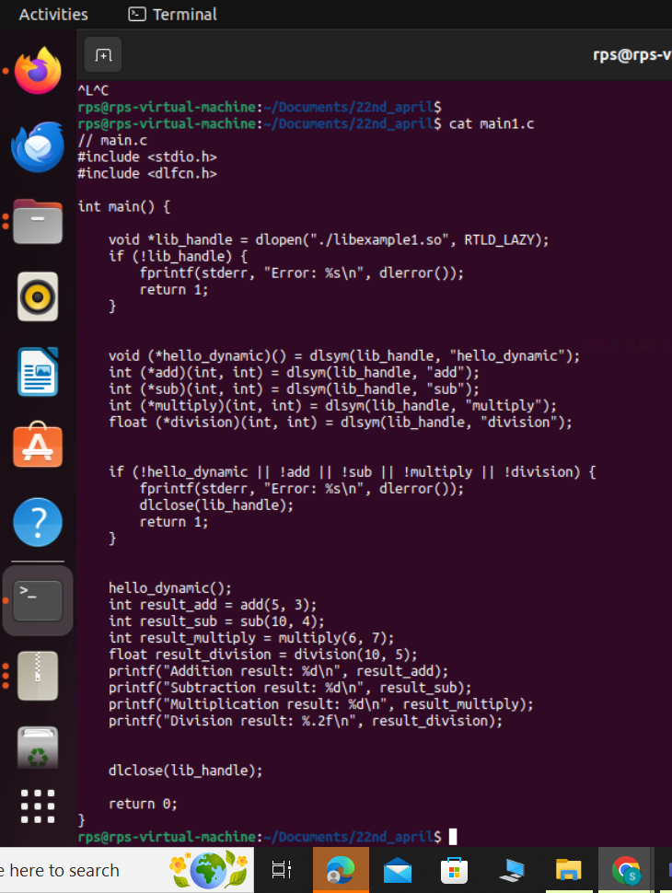
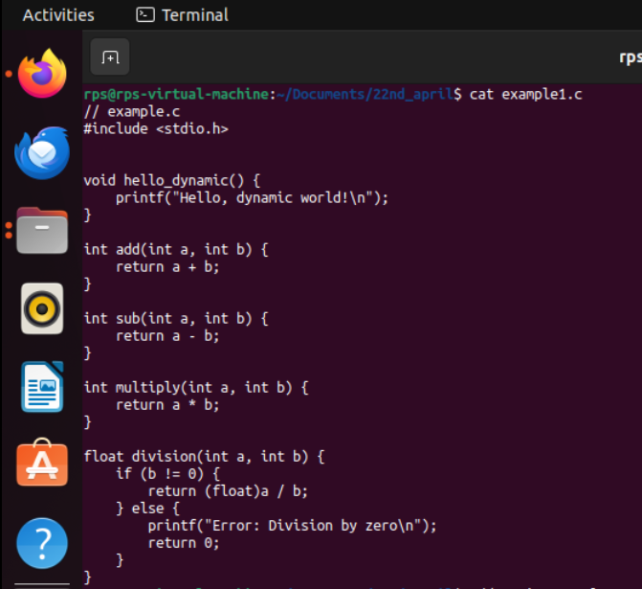
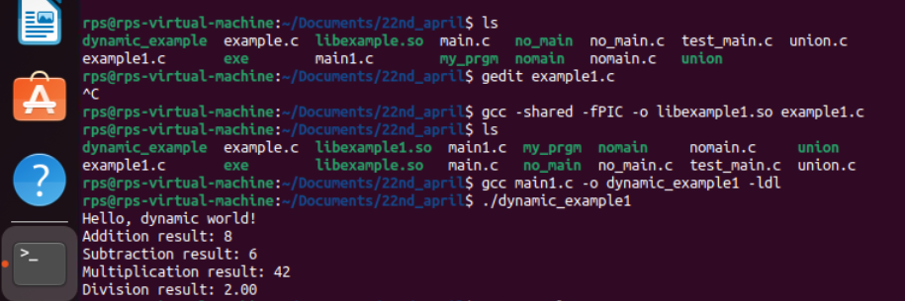
CALCULATOR PROGRAM WITH DLOPEN

Slide 6
THANK YOU

